Slide 1

Time series data analysis and forecast methods
Lecture 7
Time series forecast

Slide 2

Lecture map
Time series forecast definition
Classification of forecasts
Examples of simple forecasts
Extrapolation of trend and tendencies
Regression methods of trend forecast
Estimated accuracy of forecast
Estimated quality of forecast from formal features

Slide 3
PART 1. TIME SERIES FORECAST DEFINITION

Slide 4
Forecast
Scientific, based on the established cause-and-effect relations and time series regularities, estimation of state and stochastic ways of progress and development for researched sample-generating processes.
A way to define the future events and observations of time series data.

Slide 5
Forecast types
Short-term
For 2-3 time samples forward;
Medium-term
For one season/cycle forward;
Long-term
For some number of seasons/cycles forward;
For one longest cycle or trend/tendency;

Slide 6
PART 2. SIMPLE FORECAST WITH EXTRAPOLATION

Slide 7
Extrapolation
The forecast construction with the well-known fitted curves and lines;
The simplest possible forecast (and the least accurate) – with constant expectation mean value observations:

Slide 8
Confidence Interval
The interval is a confidence interval, when relatively to it with predefined probability we can assert, that the forecasted value is within this confidence interval;
Confidence interval consists of two boundaries/borders: upper and lower;

Slide 9
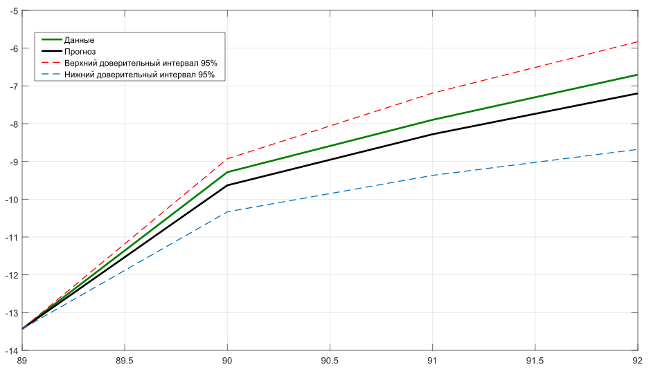

Slide 10
Confidence Interval
For the simplest mean forecast, confidence interval is:
where – t-Student value, N – length of data;

Slide 11
Forecast of mean absolute gain
Test the absolute gains:
If they are almost equal throughout the data:
Check the inequality:
If the check is true, then:

Slide 12
Forecast of mean expansion factor
If the expansion factor T_{p} is almost constant, then the tendency of this time series is subjected to the geometric progression

Slide 13
PART 3. TIME SERIES TREND / TENDENCY FORECAST

Slide 14
Trend Forecast
Trend is the simplest part of any data;
We can estimate trend simply with regression or smoothing procedure
Exponential form of trend gives us the forecast instantly, due to its recurrent form:
For a smoothed trend it is still needed to be curve fitted with polynomial first, and only then it can be forecasted with regression methods;

Slide 15
Forecast based on regression
Assuming the generalized least-squared method of trend data fitting, we have found a regression equation, as a function of time;
With every next step of time sample we estimate the future observations of data;
And we also will need a confidence interval;

Slide 16
Confidence Interval Estimation
If the constructed forecast model is adequate, then with probability α we can assert, provided that the tendency development is maintained, the forecasted observations will be within/inside the confidence interval.

Slide 17
Confidence Interval Estimation
For a linear trend:
where – residual data, or the difference between initial data and its model

Slide 18
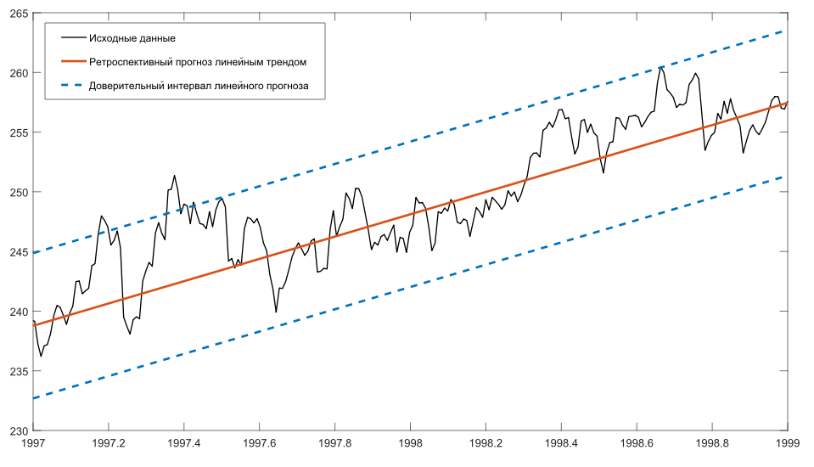

Slide 19
Confidence Interval Estimation
For a quadratic trend:

Slide 20
PART 4. Estimated accuracy AND QUALITY of forecast

Slide 21
Forecast accuracy
The empirical measure of forecast accuracy is the value of error, which defines the difference between the forecasted and the factual, real observation of data;
Retrospective forecast (hindcasting) –
Forecast observations are estimated for the already known time samples with actual real observations at hand;
Used for a test of forecast accuracy;

Slide 22
Forecast accuracy indicators
Analytical indicators for the forecast accuracy;
Comparative indicators for the forecast accuracy;
Qualitative indicators for the forecast accuracy.

Slide 23
Analytical indicators
Absolute forecast error:
Relative/fractional forecast error:
All of these errors are for a point prediction

Slide 24
Analytical indicators
Average forecast error:
Root-mean-square error (RMSE):

Slide 25
Analytical indicators
Average approximation error:
Up to 10%: high forecast accuracy
Up to 20%: good forecast accuracy
Up to 50%: satisfactory forecast accuracy
More than 50%: inadequate forecast accuracy

Slide 26
Comparative accuracy indicator
Correlation coefficient:
This indicator reflects the linear correlation between two values and only specifies a relationship between the real observations and forecasted values;

Slide 27
Qualitative indicators
Quality forecast coefficient:
ratio between exact fit predicted observations and all factual future observations.
The problem is – how to measure the exact fit, how close are they need to be?

Slide 28
Qualitative indicators
Misfit Coefficient
First Modification:

Slide 29
Qualitative indicators
КН₁=0 is the exact fit between factual and forecasted observations;
КН₁=1 is the accuracy of the simplest mean extrapolation;
КН₁>1 is the accuracy worse, than the forecast based on constant mean value

Slide 30
Qualitative indicators
Second Modification:
The ratio between the forecast SMSE and the variance estimation on the forecast interval

Slide 31
Qualitative indicators
Third Modification:
The ratio between the forecast SMSE and the linear trend forecast SMSE on the forecast interval

Slide 32
Qualitative indicators
Overall, qualitative indicators show how good or bad the constructed forecast compared to:
КН₁ – constant mean value forecast;
КН₂ – time series variance estimation;
КН₃ – linear trend extrapolation;

Slide 33
References
Chris Chatfield. Time-Series Forecasting. — Chapman and Hall/CRC; 1st ed. — 2000. — 280 p. ISBN 978-1584880639
Box G., Jenkins G. Time Series Analysis: Forecasting and Control. — 4th ed. Wiley. — 2008. — 784 p.

